Slide 1
Wedding planner
Name :- Milan Mandaliya
Roll No :- 277
Subject :- Advanced web designing

Slide 2
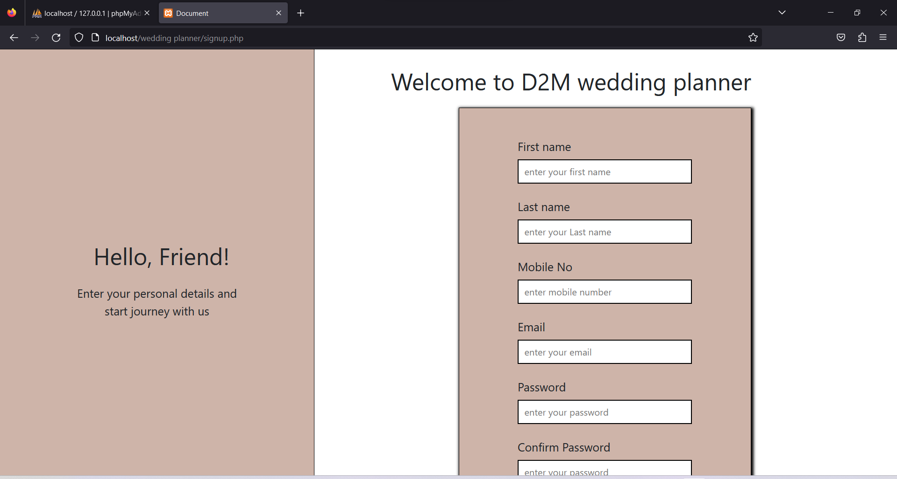
Registration Page

Slide 3
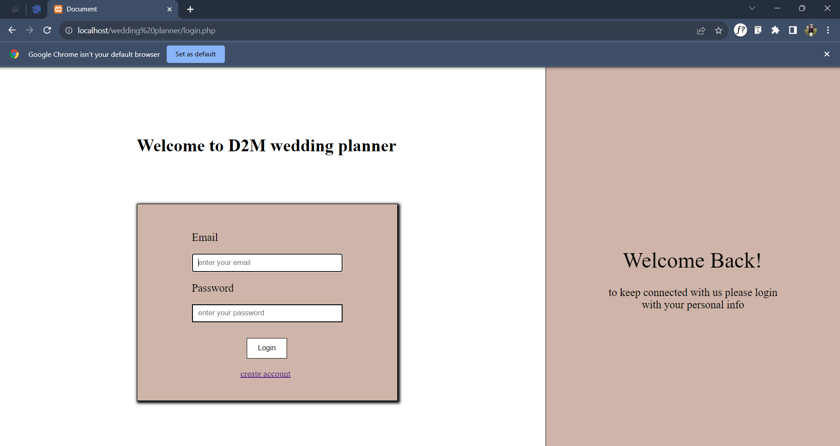
Login page

Slide 4
Customer view

Slide 5
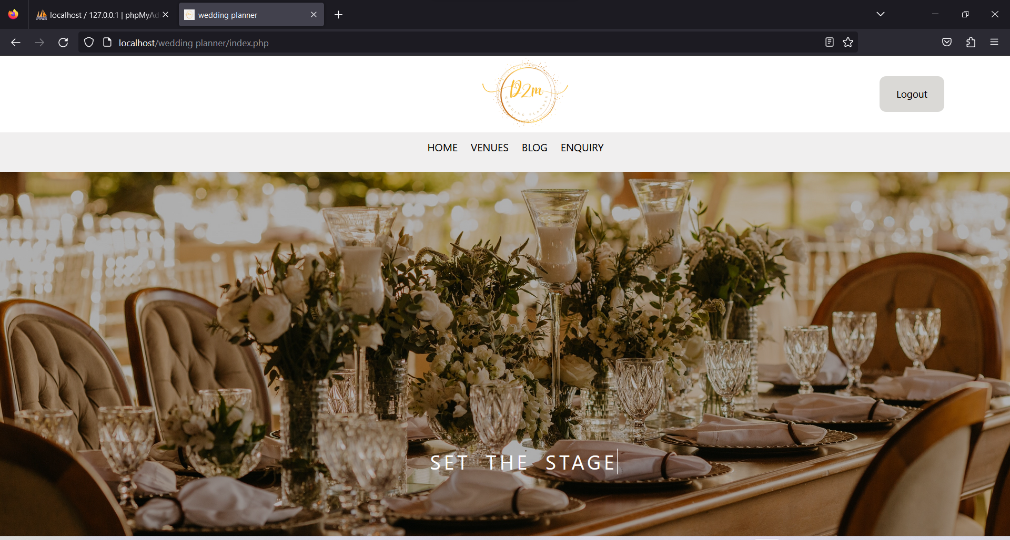
Home page

Slide 6
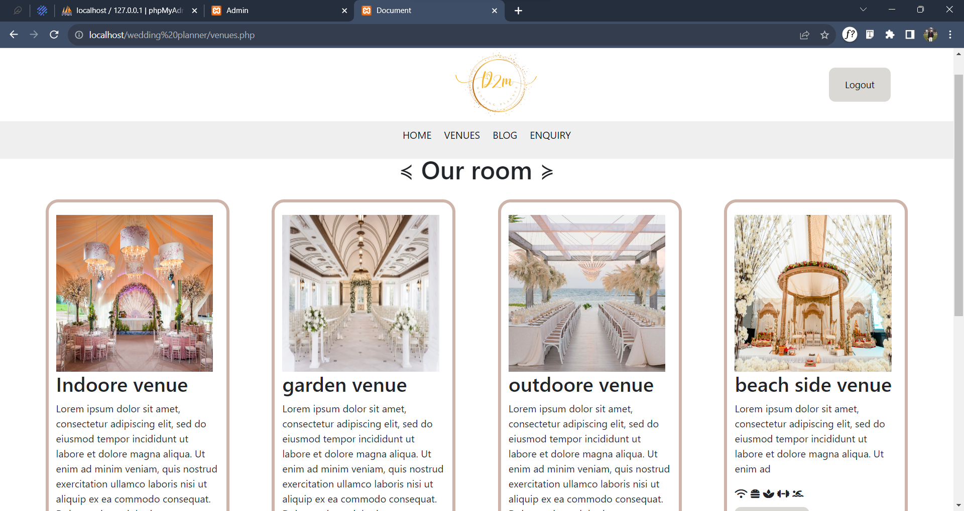
Venues

Slide 7
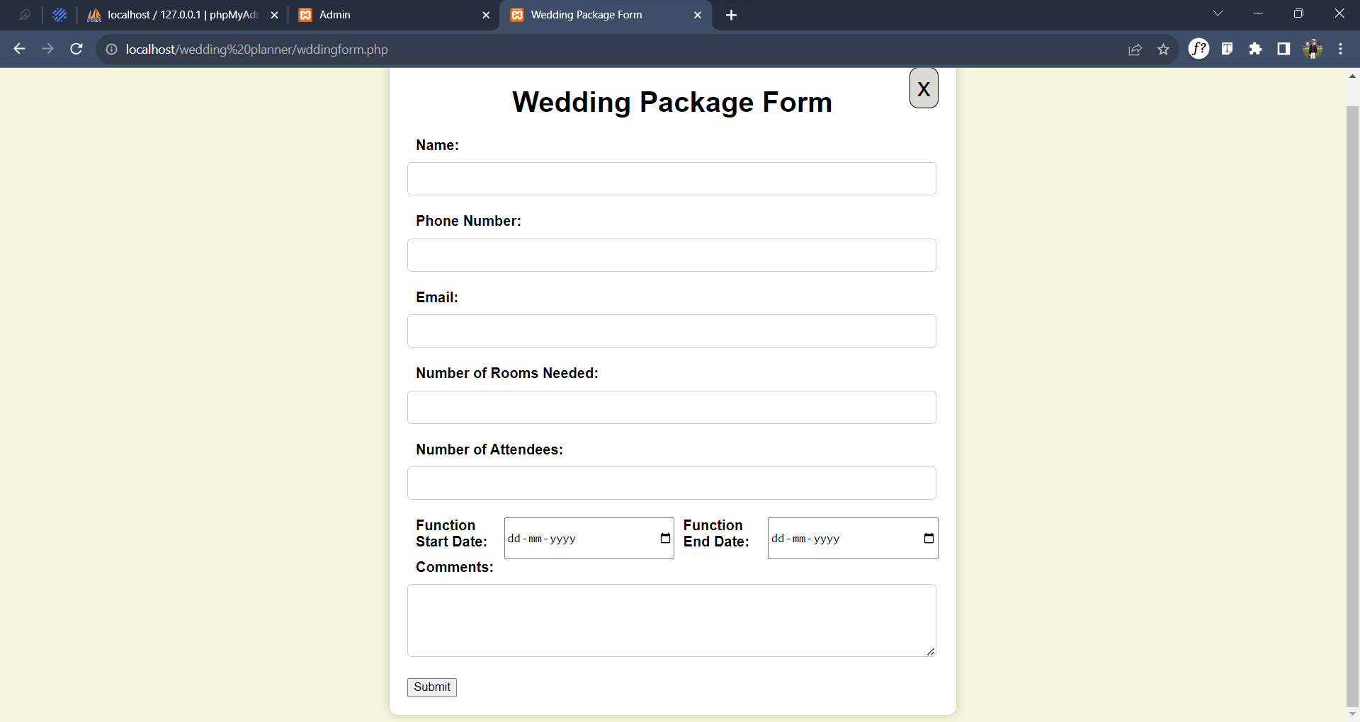
Book weddinng place

Slide 8
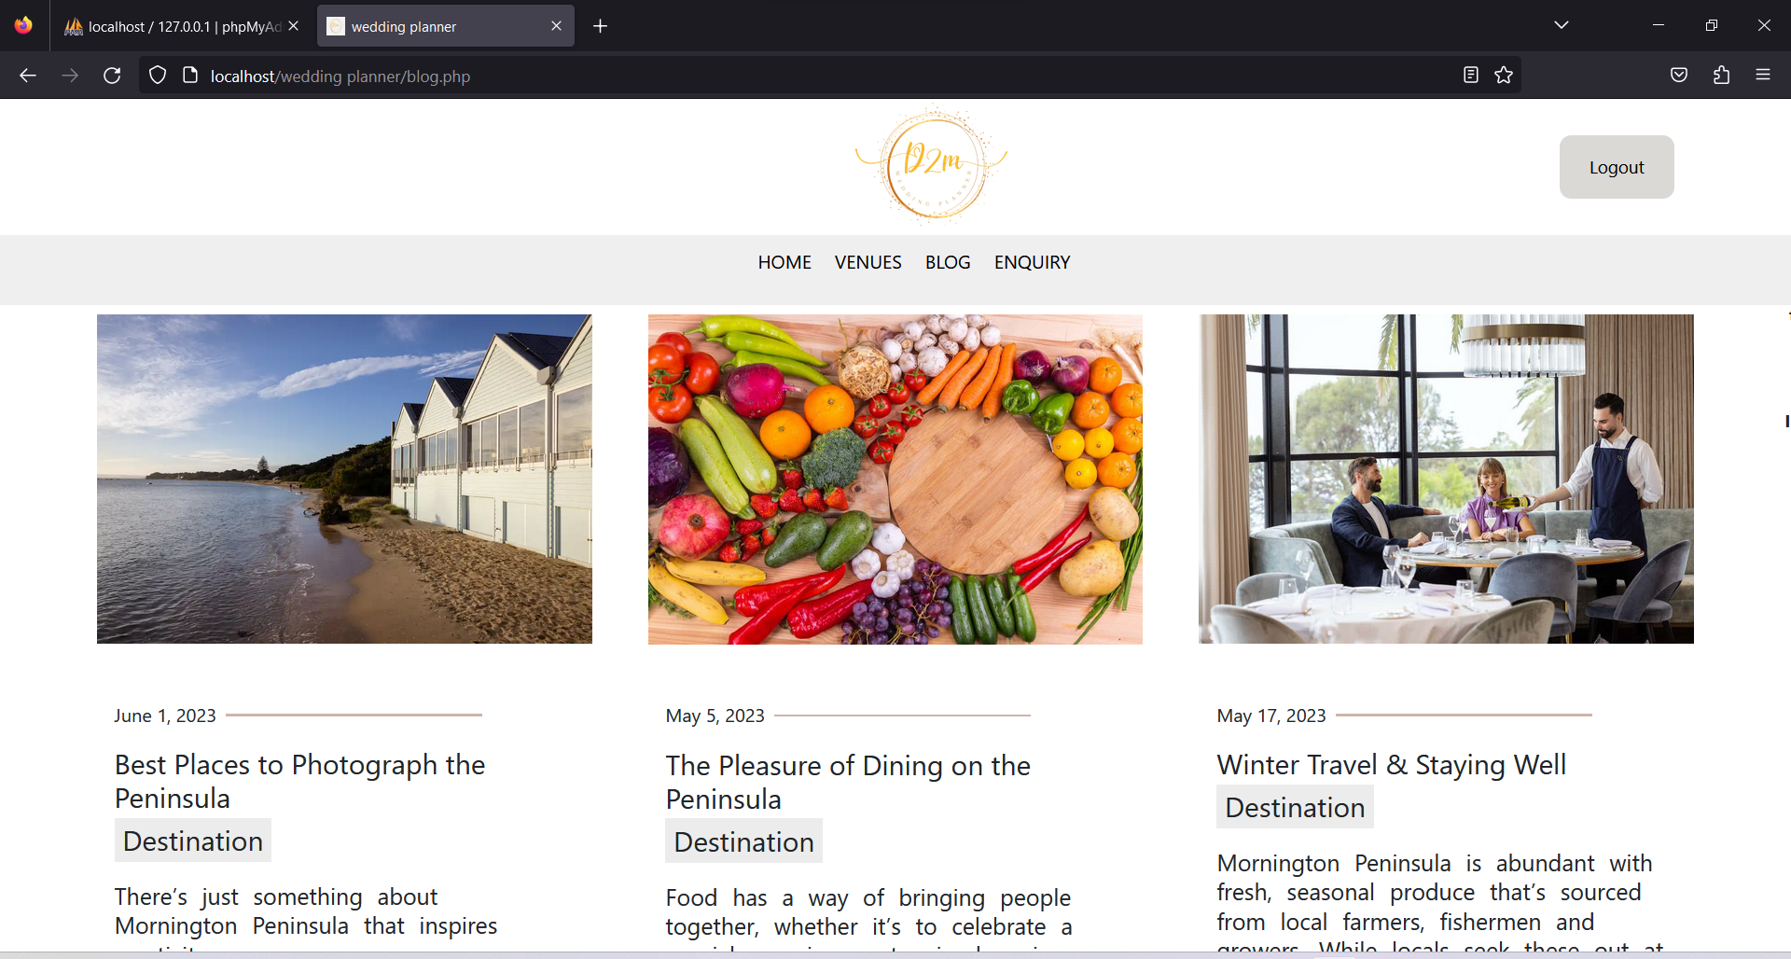
Blog

Slide 9
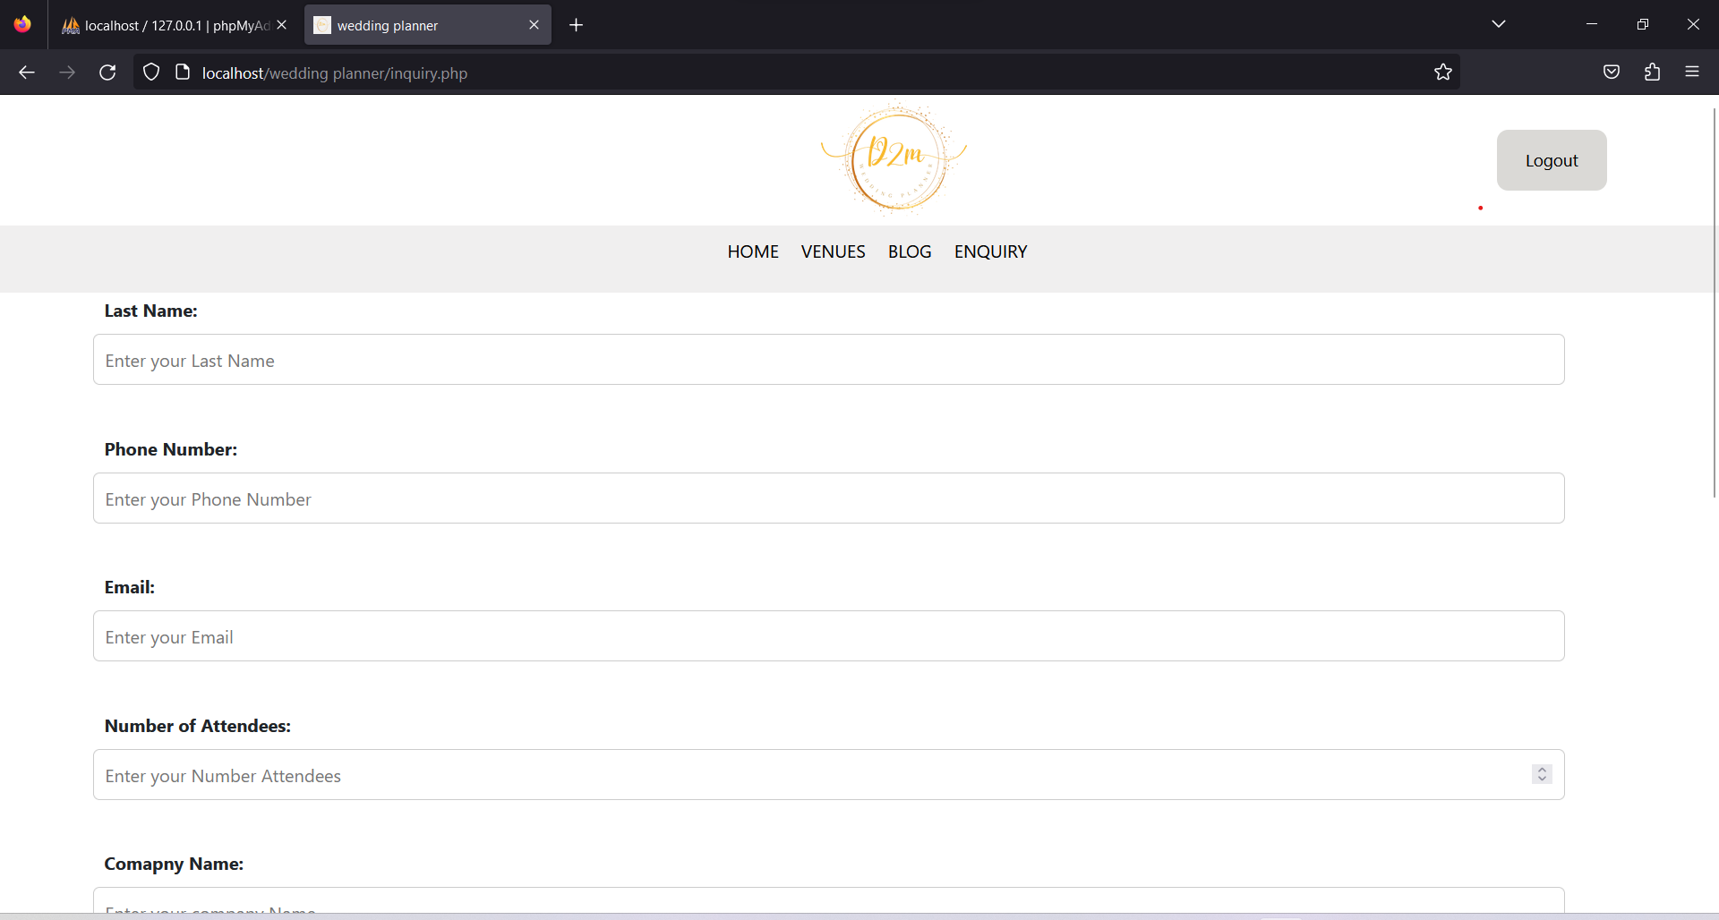
Enquiry

Slide 10
Admin view

Slide 11
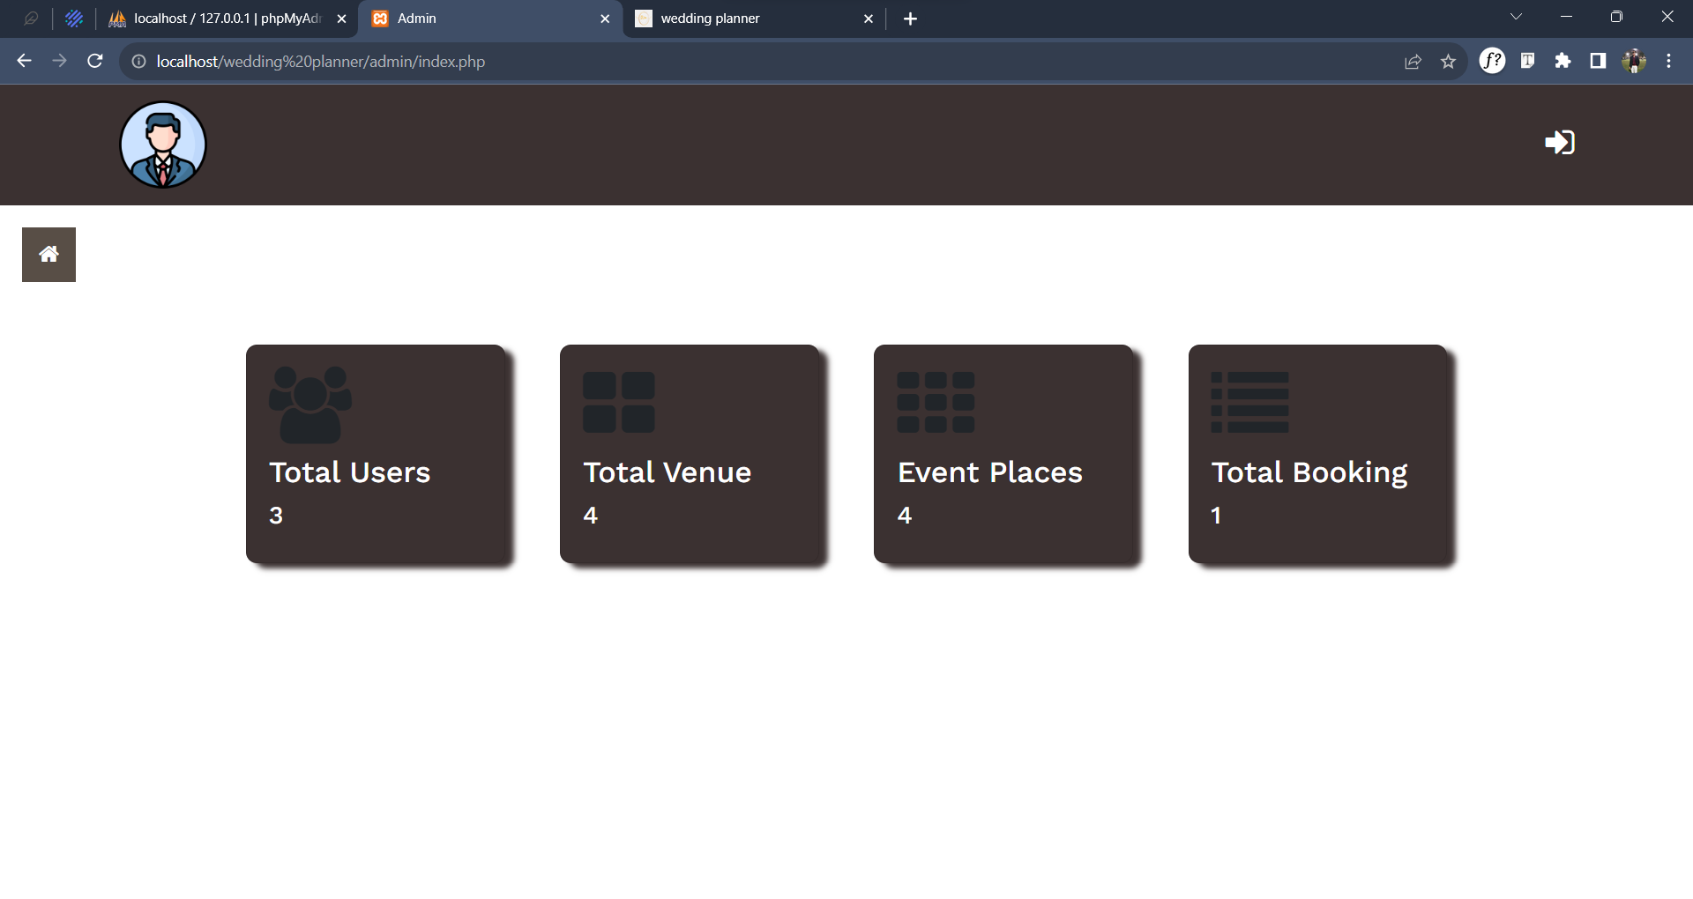
Dashboard

Slide 12
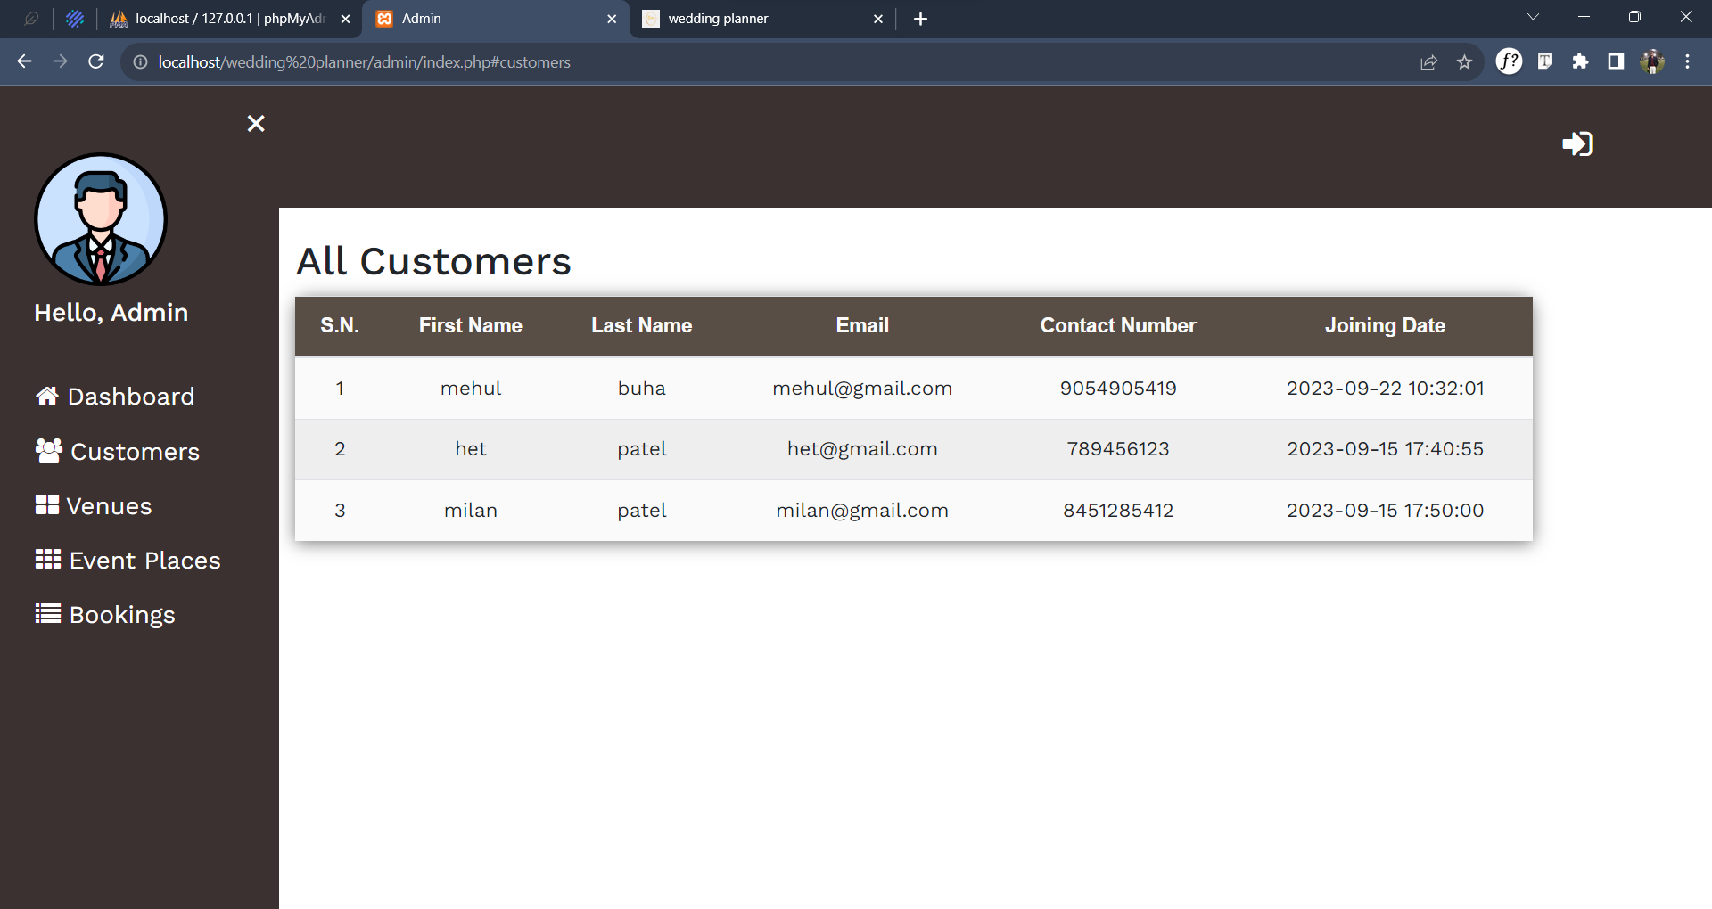
customers

Slide 13
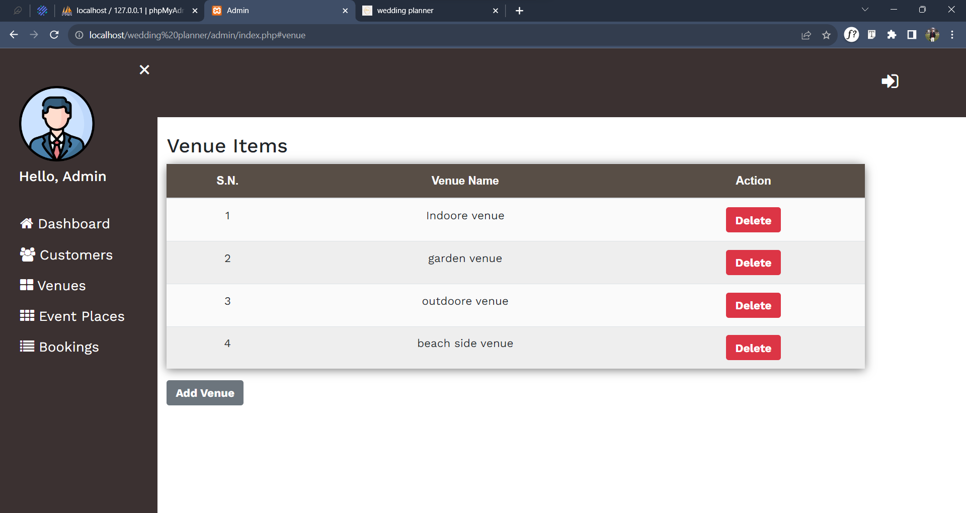
venues

Slide 14
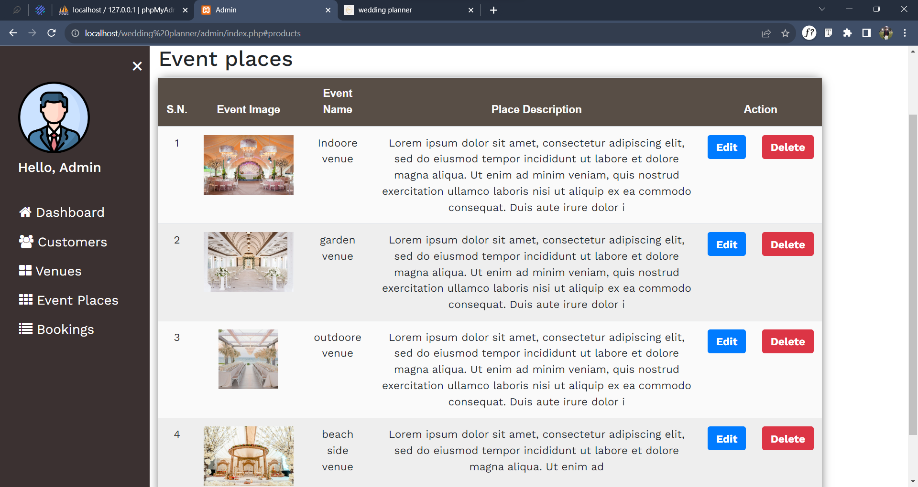
Event places

Slide 15
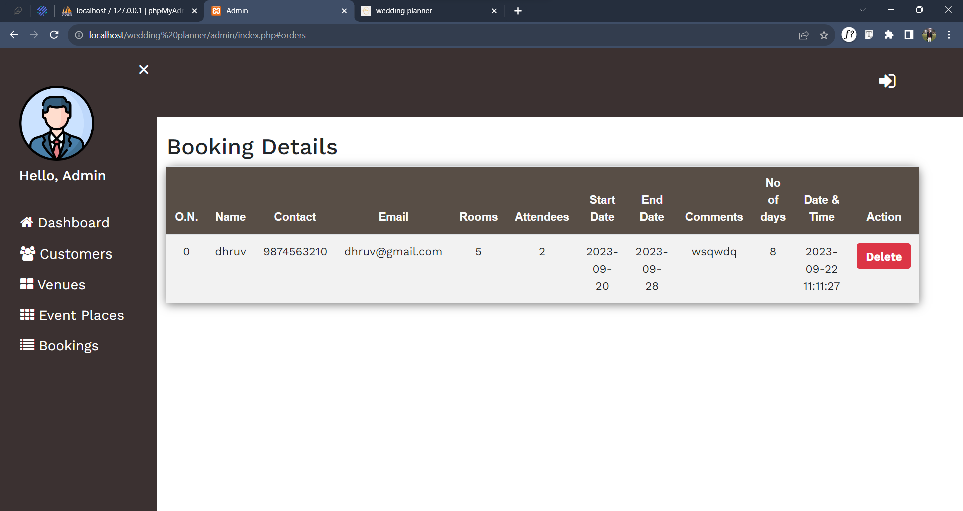
Bookings

Slide 16
Thank you

